Slide 1
Customer Personality Analysis
December 2021
Amoa Acqua Chris

Slide 2



Problem statement
Customer segmentation is important for profitability. A successful business understands its markets segmentation and works towards developing products best suited to its customers. We will dig into the personalities of our consumers throughout this presentation to help the company change its product based on its target customers from various customer groups. This will enable us to identify which customer segment is most likely to buy a new product and then advertise it exclusively to that group.

Slide 3
Objectives
01
Examine the purchasing habits of our customers, to help determine the average amount they spend on our products.
02
Share analysis on what type of product these customers lean towards the most.
03
Discuss the potential customer segment to which our new product advertisement should be directed towards for maximum profit.

Slide 4
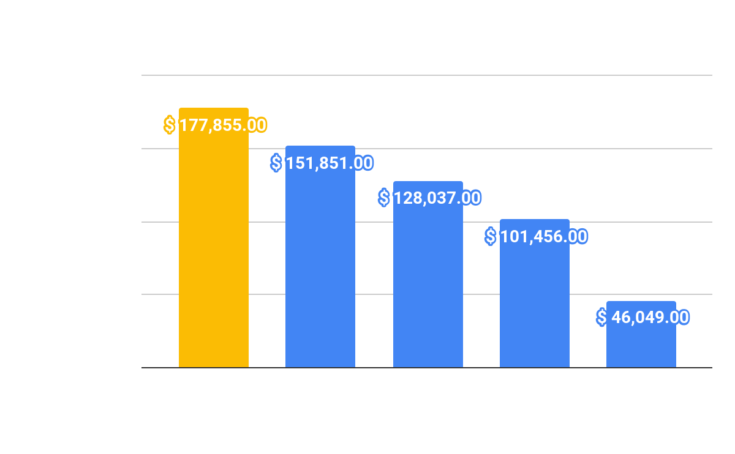
Customer average spending based on Age segment.
The data shows the average amount of each customer Age segment.
Customers aged 45 to 54 spend a total of $177,855 on our items, accounting for 29.4% of the total amount spent.

Slide 5
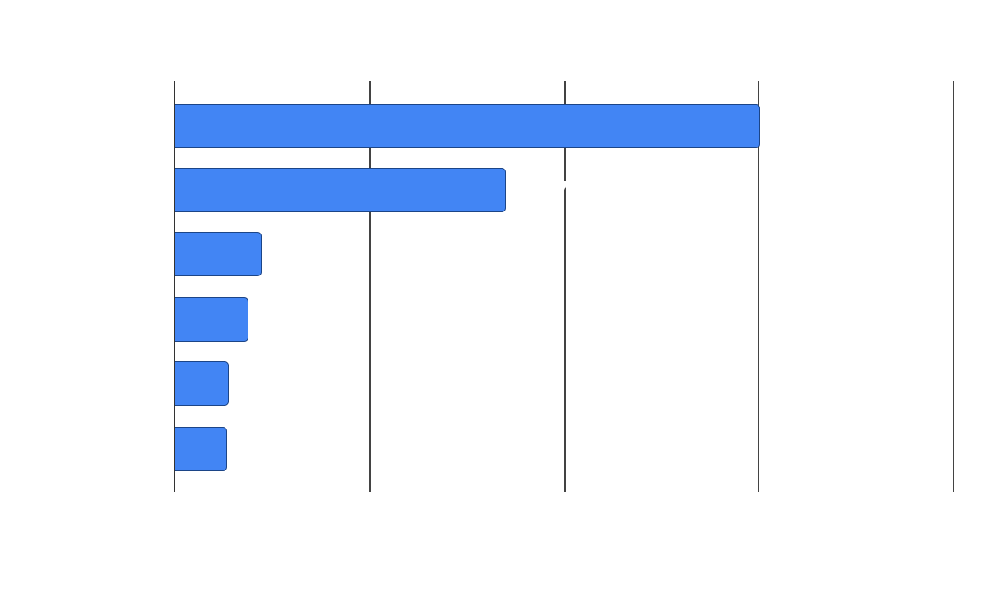
Indicating which product is the most purchased.
Most of our consumers spend more money on Wines.
Customers spent an average of $300.19 on Wines, bringing in a total of $300,193 in sales.

Slide 6
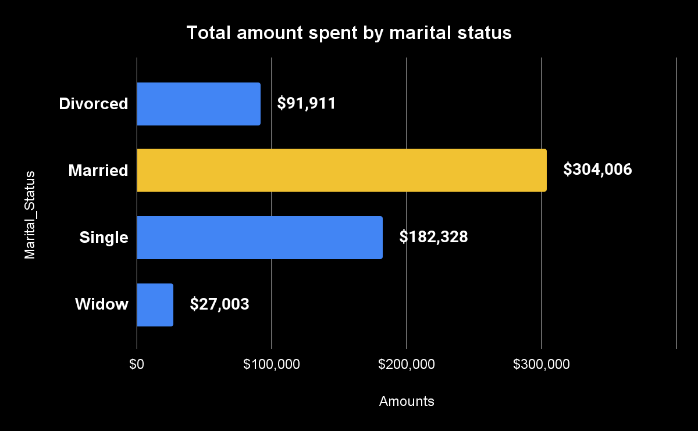
Total amount of sales categorized by the marital status of our customers.
Data gathered, helps understand how much money is spent by customers based on their marital status.
It is evident that married couples spend more ($304,006) on our product. This could be driven by the number of children they have.

Slide 7
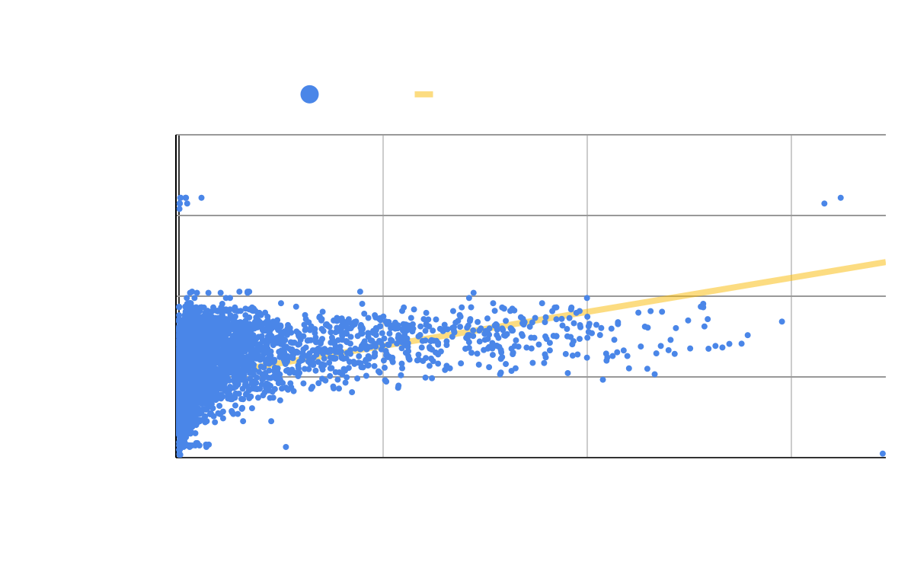
Does the amount of money a consumer earns have an impact on how much they spend?
As we can see from our diagram, as income rises, so does the amount spent.
The average annual salary of our clients is $52,000.
This demonstrates that earned income is a factor that contributes to a rise in overall spending.

Slide 8
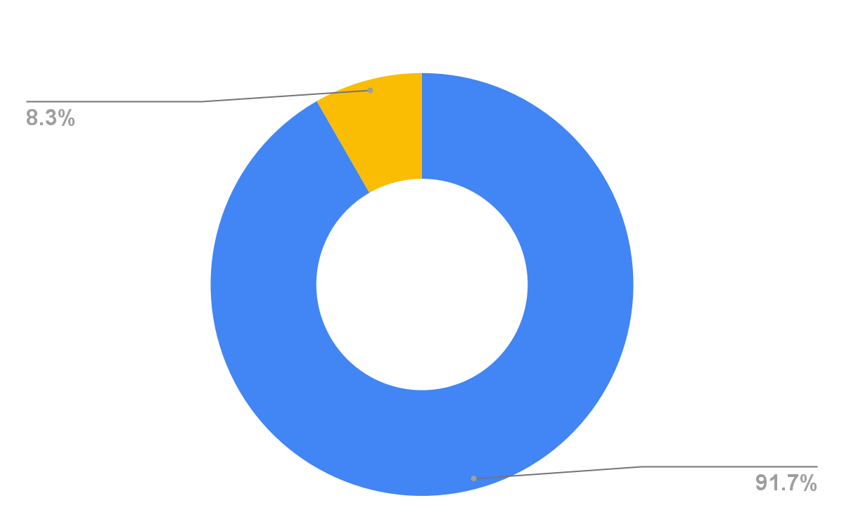
A representation of our customers in percentage considering their educational status
A large proportion of our consumers hold postgraduate degrees. They make up 91.7% of our overall clients, whereas undergraduates make up 8.3%.

Slide 9

Conclusion
In summation, we may argue that focusing on clients aged 45 to 54 will aid in the dissemination of information about our new items. We should also target married couples that have a proclivity for spending ($304,006). We should offer our new items to clients who make more than the average wage ($52,000), as well as those with postgraduate degrees, to help boost sales.

Slide 10

Thank you!

